Slide 1
Visualize Your Connections
A Practical Guide to Power BI Graphs
Jake Duddy

Slide 2


Special thanks to Fabric and Power BI Team at
This Summit presented to you by

Slide 3


Speaker info
Data Platform Microsoft MVP
Fabric Community Super User
EvaluationContext Blog
Devon and Cornwall Power BI Group Co-organizer

Slide 4
Agenda
What are Graphs
How can you structure graph data for Power BI
How can you visualize the graph in Power BI

Slide 5
What Are Graphs

Slide 6


Slide 7
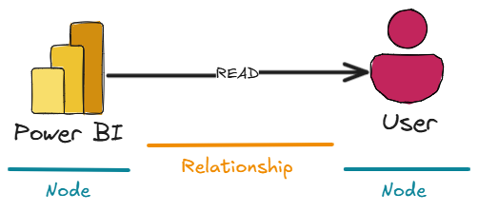
Nodes and Relationships

Slide 8
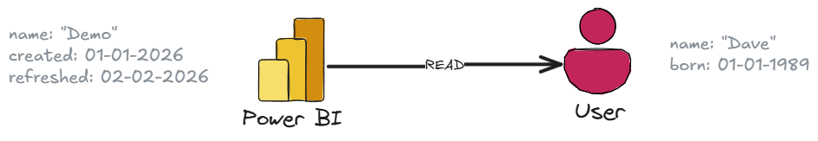
Detailed Property Graph

Slide 9
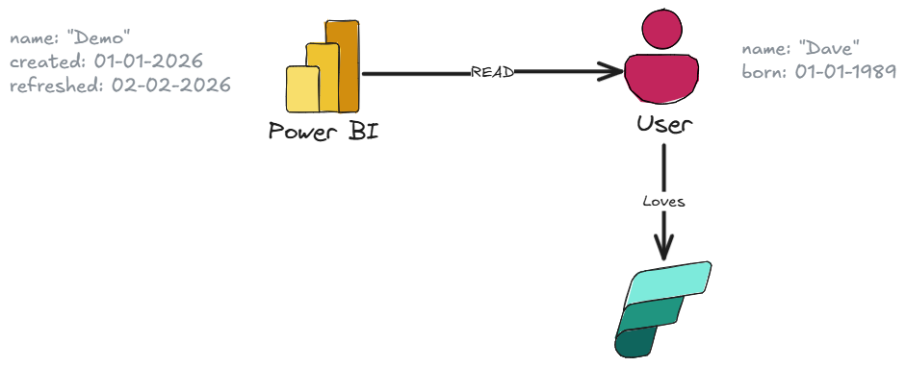
Detailed Property Graph

Slide 10
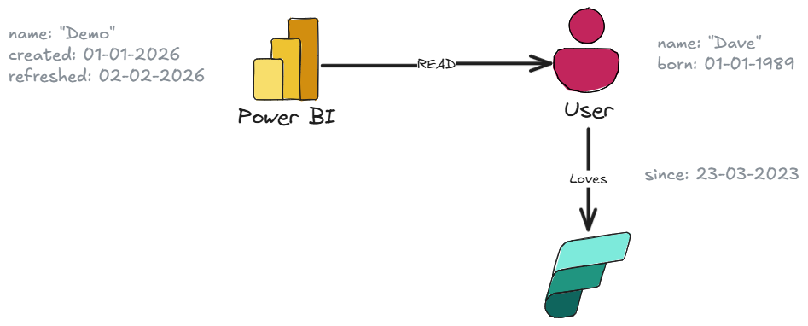
Detailed Property Graph

Slide 11
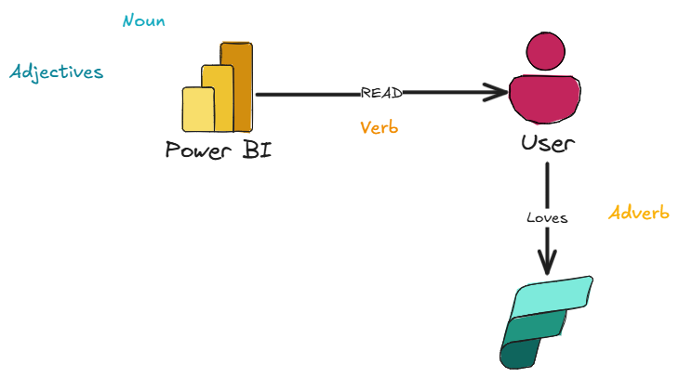
Detailed Property Graph

Slide 12
How Can You Structure Graph Data For Power BI

Slide 13
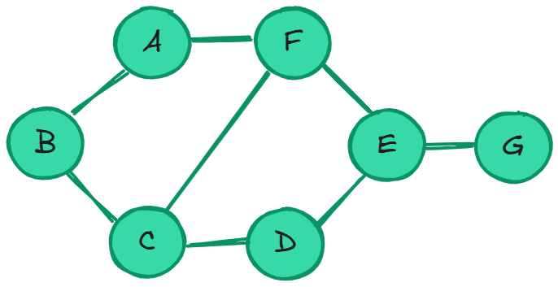
Adjacency List
Good for sparse graphs, few edges
Bad option for Power BI
A | (B, F)
B | (A, C)
C | (B, D, F)
D | (C, E)
E | (D, F, G)
F | (A, E)
G | (E)

Slide 14
Adjacency Matrix
Poor compression when considering sparse graphs, better for dense
Bad option for Power BI
 | A | B | C | D | E | F | G
A | 0 | 1 | 0 | 0 | 0 | 1 | 0
B | 1 | 0 | 1 | 0 | 0 | 0 | 0
C | 0 | 1 | 0 | 1 | 0 | 1 | 0
D | 0 | 0 | 1 | 0 | 1 | 0 | 0
E | 0 | 0 | 0 | 1 | 0 | 1 | 1
F | 1 | 0 | 1 | 0 | 1 | 0 | 0
G | 0 | 0 | 0 | 0 | 1 | 0 | 0

Slide 15
Nodes and Relationships
Nodes (Vertices) and Relationships (Edges) are stored as separate tables
Ok option for Power BI
Nodes
A
B
C
D
E
F
G
Edges
src | dst
A | B
B | A
B | C
C | B
… | …
G | E

Slide 16
Triplets
Nodes and Relationships stored in the same table
Good option for Power BI
src | dst
A | B
B | A
B | C
C | B
A | F
… | …
G | E

Slide 17
Who Has Access To What in Fabric?

Slide 18


How Can Access What in Fabric
Data
Scanner API
  Workspaces, Items and metadata
workspaces
users
Graph API
  User Groups and Members
reports
users
datasets
Creating the Graph
Spark: Graphframes (Pregel)
SQL: Recursive CTE
users
tables
columns
measures
…
…

Slide 19
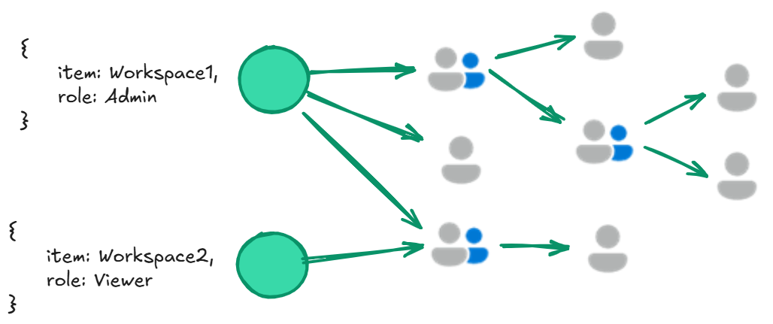

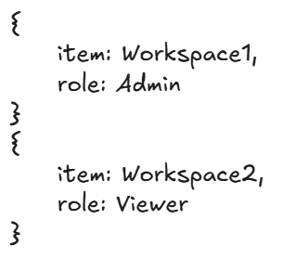
Pregel
Multiple iterations of Supersets
  Per Superset
    Map: Every vertex sends a Message to adjacent vertices via edges
    Reduce: Each vertex combines the received messages

Slide 20
How can you visualize the graph in Power BI

Slide 21
Demo

Slide 22
Trimming the Graph
To trim a sub-graph to only relevant graph to edges and nodes, you would need to loop through the graph to remove irrelevant nodes
Python and R
  Limitations
  Row Limit: 150,000 rows
  Non-interactive
  Personal Gateway
Why not use a different engine, built for graph processing?
  Fabric
    KQL Database
    Cosmos (in preview)
  Direct Query and Dynamic M Parameters

Slide 23
Kusto Graph Semantics - 1
Transient Graph
  Small to medium datasets
  Exploratory/Ad hoc
  Frequently changing data
Persistent Graph
  Graph snapshot
    Eliminate graph construction latency for repeated queries
    Consistency
  Can scale to multiple billions of nodes and edges

Slide 24
Kusto Graph Semantics - 2
All employees aged < 30 who report directly and indirectly to Alice
// Transient Graph
reports
| make-graph employee --> manager with employees on name
| graph-match (alice)<-[reports*1..5]-(employee)
where alice.name == "Alice" and employee.age < 30
project employee = employee.name, age = employee.age,
reportingPath = map(reports, manager)

Slide 25
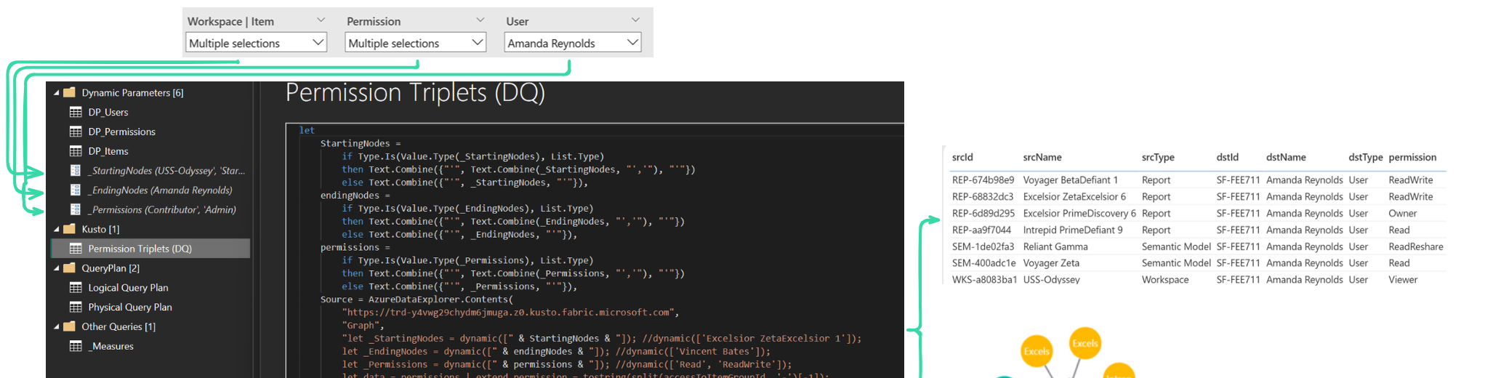
Dynamic M Parameters
Direct Query
Filter or slicer values on report injected into a M parameter

Slide 26
Demo

Slide 27
DAX Query Plan

Slide 28
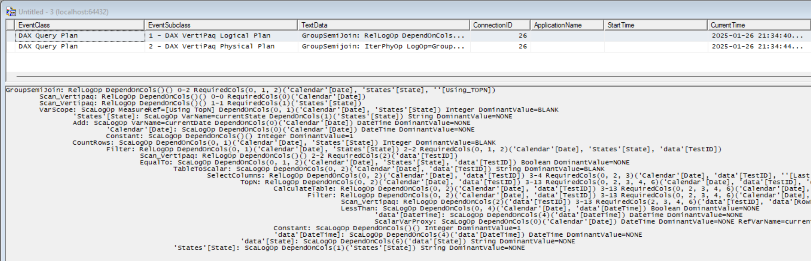
DAX Query Plan
Each increase in indent represents a nested operation

Slide 29
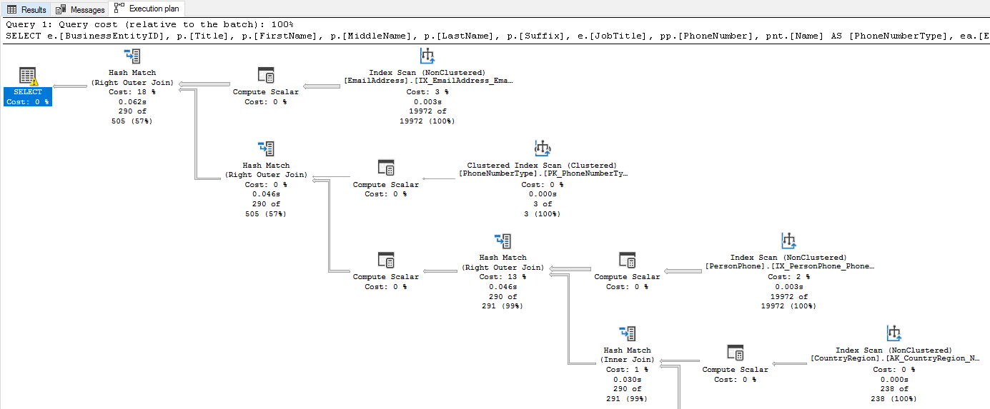
SQL Server Query Plan

Slide 30
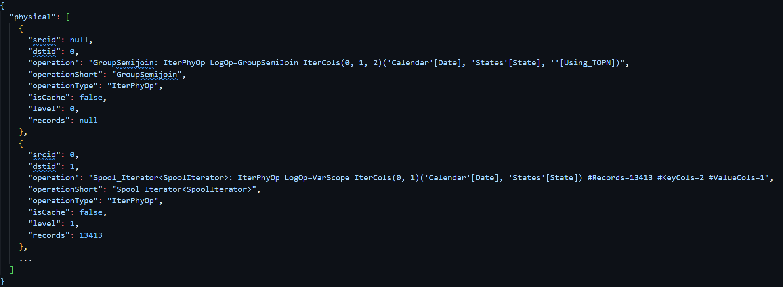
DAX Query Plan To Graph
Parse XML to dict
Split indents to generate Physical and Logical Plans Graphs

Slide 31
Demo

Slide 32
Resources to study more
Deneb
Davide Bacci Vega Template
Visualizing Power BI Permission Inheritance
Smarter Subgraphs - Kusto as a Engine For Power BI
Graphing DAX Query Plans
Kusto Graph Semantics
Dynamic M Parameters

Slide 33




Thank you
Connect to me at:
Stay online for my live Q&A sessions
evaluationcontext.github.io/
linkedin.com/in/jakeduddy/

